Slide 1
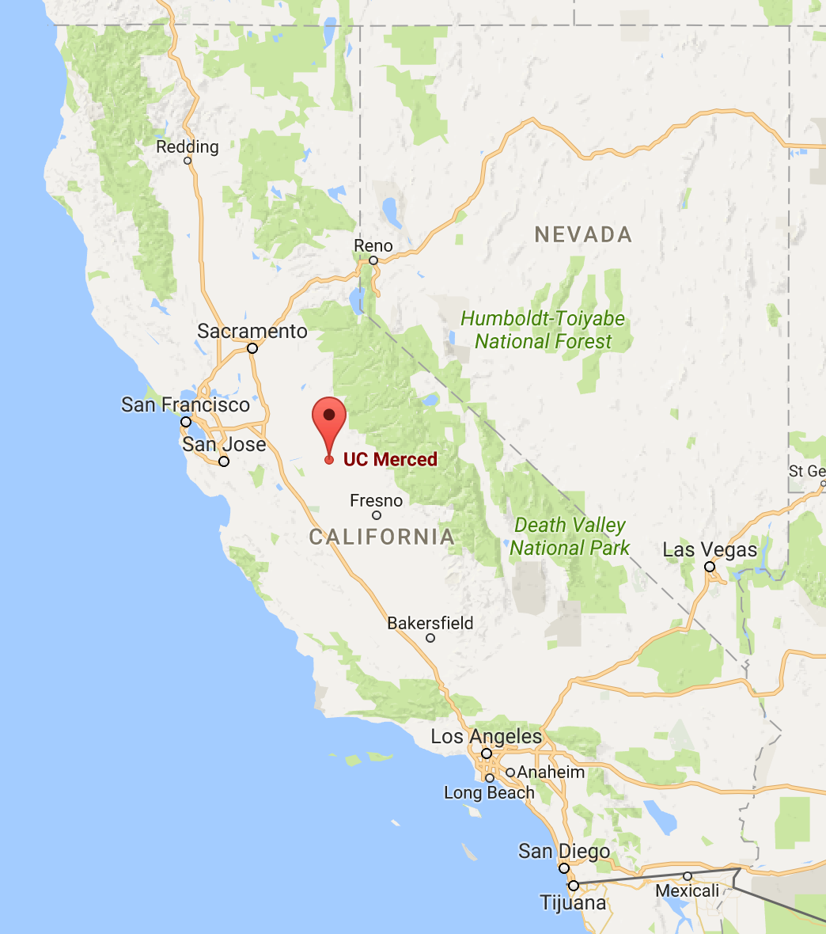
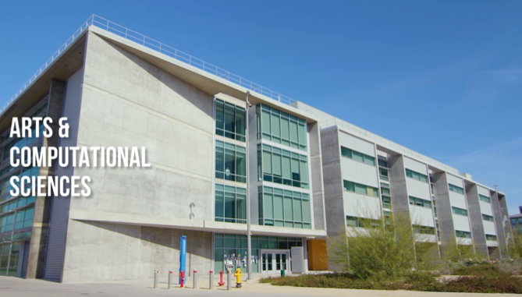
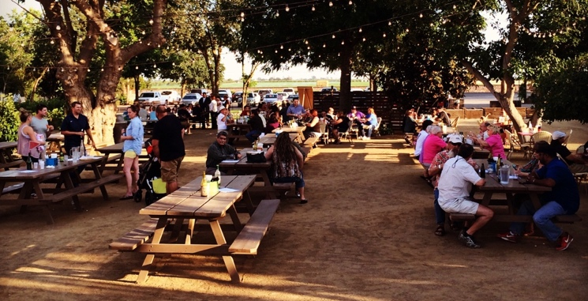
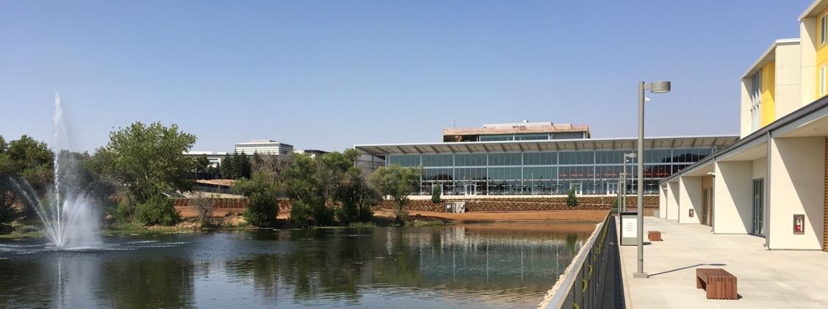
2021 Electronic Structure Workshop at University of California, Merced: 1-4 June 2021
Organizing committee David Strubbe and Aurora Pribram-Jones, UC Merced Steven Louie and Jeffrey Neaton, UC Berkeley and LBNL
Newest UC campus, founded 2005
2 hours’ drive from San Francisco and Yosemite Nat’l Park
Hosted in brand-new buildings, banquet at nearby vineyard
https://physics.ucmerced.edu/electronic-structure-workshop

